Slide 1
Self-Determination: STRATEGIES FOR ENHANCING TRANSITION TO EMPLOYMENT FOR YOUTH WITH DISABILITIES
SUSAN LOMBARDO
MARCH 9, 2016

Slide 2
OBJECTIVE FOR TONIGHT’S PRESENTATION
Provide a background on self-determination and how it became recognized as best practice in transition services for youth with disabilities
Discuss why self-determination is important for students with disabilities in employment
Present how the self-determination components of goal setting and self-management can be used to prepare students with disabilities for employment

Slide 3
To put it simply …
“People who are self-determined make things happen in their lives. They know what they want and how to get it. They choose and set goals, then work to reach them. They advocate on their own behalf, and are involved in solving problems and making decisions about their lives” (Wehmeyer, Abery, Mithaug, Stancliffe, 2003) .

Slide 4
FUNCTIONAL MODEL OF SELF-DETERMINATION:
“Individuals who demonstrate self-determined behavior act as the “primary causal agent in one’s life and making choices and decisions regarding one’s quality of life free from undue external influences or interference” (Wehmeyer, 1996, p. 24)

Slide 5
Individuals with Disabilities Education Act (IDEA) mandates increased student involvement in transition planning
Involves addressing the knowledge, skills, and attitudes students will need to take more control and responsibility for their lives
Evidence from spec ed. literature reveals that “enhanced self-determination leads to more positive adult outcomes,” especially in the area of employment

Slide 6
Higher self-determination and increased capacity in the component elements of self-determined behavior results in better transition-related outcomes for our youth and young adults with disabilities.
(Wehman, P., & Wittig, K., & Dowdy, V.)

Slide 7
MY FOUR-STEP METHOD FOR SETTING AND REACHING MY GOAL
NAME:
START DATE:
END DATE:
IDENTIFY MY GOAL:
WRITE MY GOAL:
CREATE MY PLAN OF ACTION:
EVALUATE MY PROGRESS AND ADJUST MY GOAL:

Slide 8
Self-Management
Teaching a person with a disability to apply behavior change strategies that result in the behaviors being changed
Umbrella term that encompasses self-regulation, student directed learning, self-instruction, self-monitoring, self-evaluation, and self-reinforcement

Slide 9
 | GOOD WORK BEHAVIOR | CHECK
1 | Look and listen when job coach gives directions.
2 | Do the job the way the job coach showed me and use my picture prompts.
3 | Say, “Would you check my work?”
4 | Ask questions when I’m not sure about anything.
5 | Accept directions without arguing.
6 | Correct mistakes, if I made some.
7 | Watch the time.
8 | Clean up my area.
9 | Say goodbye to John before I leave to get bus back to school.

Slide 10
Reminders:
Stop, listen, and then act
Stay focused on my job.
I earn an ‘A’ when I have 8-9 checks
I earn a ‘B’ when I have 7-8 checks
I earn a ‘C’ when I have 6-7 checks
I earn a ‘D’ when I have 5-6 checks
I earn an ‘F’ if I have less than 6 checks

Slide 11
FRIDAY | 11/21 | 12/05 | 12/12 | 12/19 | 01/08
FICTION/ LITERATURE # OF BOOKS SHELVED
MYSTERY # OF BOOKS SHELVED
ROMANCE # OF BOOKS SHELVED
SCIENCE FICTION # OF BOOKS SHELVED
TOTAL # BOOKS SHELVED
Notes:
This is another option for an Overview slides using transitions.

Slide 12
INCENTIVE POINT SYSTEM:
You will receive 1 point for every book you shelve correctly:
25 – 30 points will get you 5 minutes at end of work to look at Manga
31 – 36 points will get you an extra 5 minutes of computer time at the end of 7th Period
When you accumulate 200 points you may leave your work site 10 minutes early to visit Gamestop and purchase a video game for under $6.00
You will receive your incentive at the end of the work period
Notes:
This is another option for an Overview slides using transitions.

Slide 13
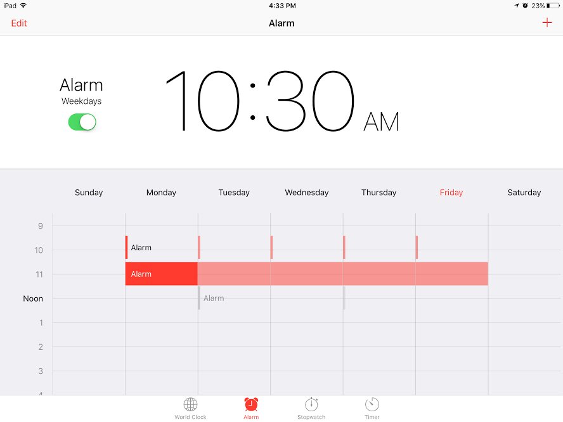

Slide 14
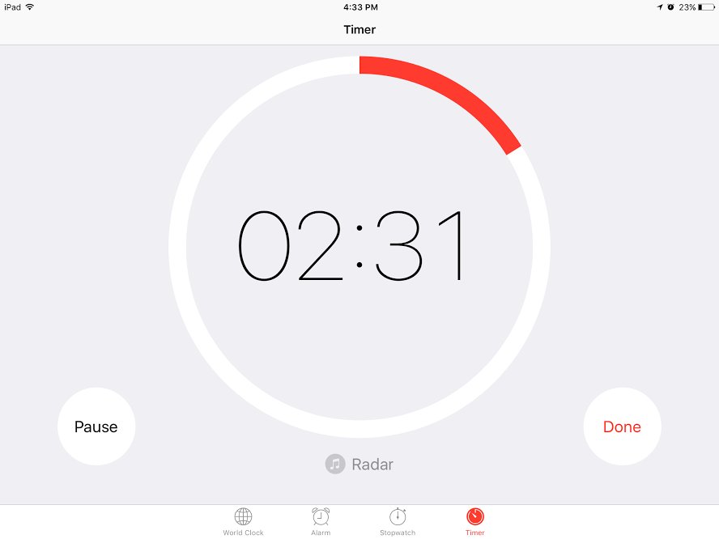

Slide 15
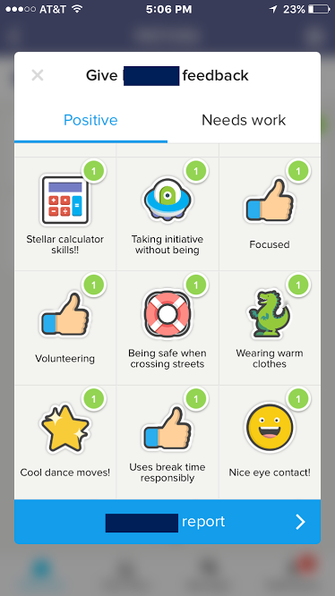

Slide 16
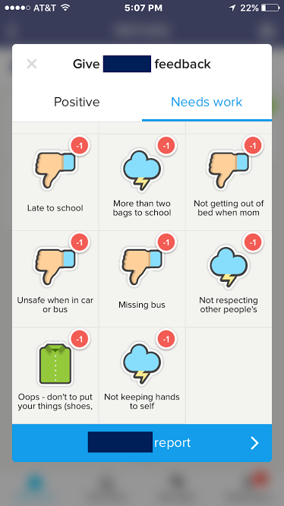

Slide 17
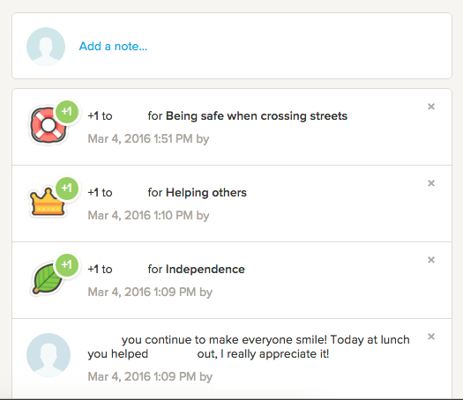

Slide 18
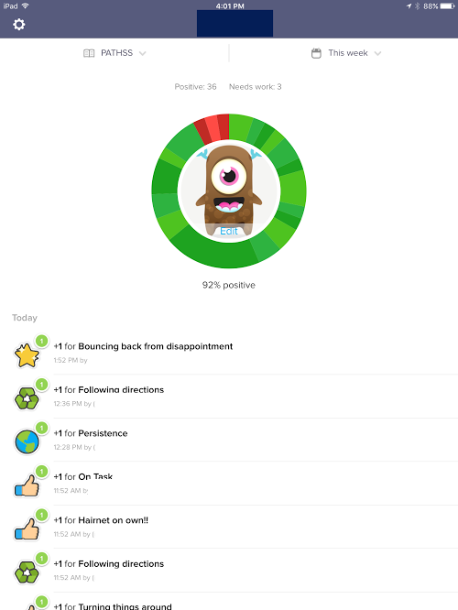

Slide 19
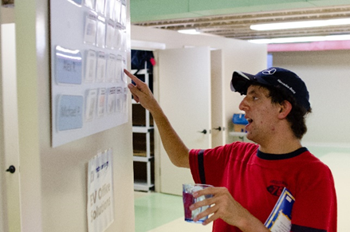

Slide 20
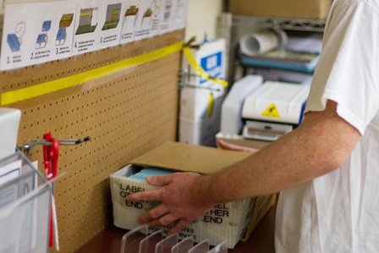

Slide 21
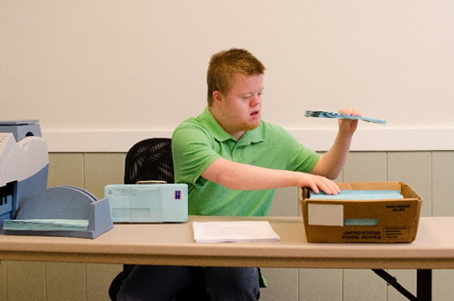
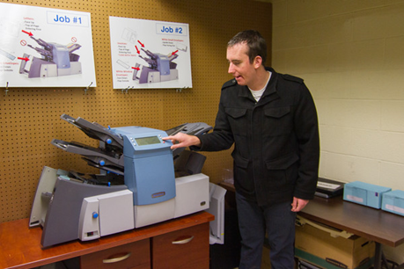

Slide 22
When students with disabilities show they can make things happen and take responsibility for planning and decision-making, others change how they view them and what they expect from them.

Slide 23
References
Wehmeyer, M.L., Abery, B., Mithaug, D.E. & Stancliffe, R.J. (2003). Theory in self-determination: Foundations for educational practice. Springfield, IL: Charles C. Thomas Publisher LTD.
Wehmeyer, M.L. (1996). Self-determination as an educational outcome: Why is it important to children, youth, and adults with Disabilities? In D.J. Sands & M.L. Wehmeyer (Eds.), Self-determination across the life span. Independence and choice for people with disabilities. (pp. 17-36) Baltimore: Paul H. Brooks Publishing Co.
Wehman, P., Witttig, K., & Dowdy, V. (2002) Transition plans for youth with disabilities. In P. Wehman (Ed.), Individual transition plans: The teacher’s curriculum guide for helping youth with special needs (2nd ed., pp. 161-166). Austin TX: PRO-ED

