Slide 1
Current Issues in Developmental Disability Advocacy: What’s Happening and What You Can Do
CIDD Community Talk Series
March 11, 2020
Jennifer Mahan, Director of Public Policy

Slide 2
Welcome!
Notes:
Jennifer Mahan, Director of Public Policy for the Autism Society of NC. ASNC has been working in North Carolina for 50 years this year, improving the lives of people with autism, supporting their families and educating communities. Thank you for inviting me to talk about what is currently happening in developmental disability advocacy.

Slide 3
Tonight’s Outline
The status of IDD services and supports
Samantha R decision
Medicaid Overview and Medicaid Transformation
Budgets: State and Federal
NC Voting Law Changes
US Census
Advocating
Notes:
I’ll be talking tonight about a range of issues going on in the state as well as a few national issues, and then my very brief take on advocating. I’ve pulled a lot of information into the time we have together tonight so I’m going to ask you to hold onto questions until the end. Some of your questions will be answered as we go along, and the rest we will cover at the end.

Slide 4
The Status of IDD Supports and Services
There is no entitlement to services and supports
People with IDD/Autism do not have a right to health care and supportive services based simply on a diagnosis
There are some services and supports for some people
People with IDD/Autism may get access to *some* health care and supportive services by meeting certain criteria for specific programs
Programs are often under funded
This isn’t the only reason people don’t have access, but it’s a major one.
Notes:
I’m going to make very clear the perspective I am working from today. There are a lot of slides that follow about how our system is trying to transform, about upcoming policy changes, and issues to keep an eye on, but I want to be sure about where things still stand today.
Despite all these efforts, we will still not have addressed the most basic issue in our system which is the lack of access to services for people with IDD. I’m hopeful that we can change this.

Slide 5
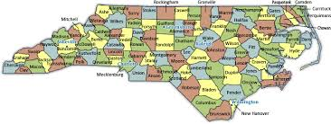
The view from NC
NC has 14,000+ people on HCBS waiver waiting list
Wait varies by county, avg 10 years, could be 20.
List only capturing those with highest needs
500 million in state dollars has been cut over 5 years from programs that serve people with MH/DD/SAS needs who are uninsured and underinsured
Health and disability services (nationwide) are a fragmented system, often dependent on employment or income status with large gaps in who and what is covered
The system is still very complicated to navigate and there are fewer built-in programs such as case management, consistently across the age ranges, to help
Notes:
I usually wait to do this until the end to do this but I want you to be thinking about this issue as I talk with you about the court decisions, Medicaid, system structure, and transformation.
There are 14,500 people on a waiting list for Innovations waiver services in North Carolina
Typical wait is 10 years, but some waits are closer to 20 because of an inequitable distribution system across counties, and ultimately because we haven’t invested resources, and there are 14,500 waiting.
There is a lack of coordination, despite services being coordinated by the same services manager, because funding and programs have different resources, eligibility, and processes to access.

Slide 6
Current Funding Streams for Services
Medicaid
Non-Medicaid
Innovations Medicaid Waiver Services (1915b/c waiver)
Other CAP waivers (CAP-C, CAP-DA)
B3 services (Medicaid through LME/MCO Per Member Per Month)
Medicaid Enhanced Benefits (Mental Health/SU)
Traditional Medicaid/Health Choice, CHIP, (OT/PT/ST/Dx, etc.)
Reinvestment Funds
IPRS - State Funded/Block grant services
Vocational Rehabilitation services
Private Pay
Private Health Insurance
Non-UCR (local) funds
DHHS Grants/direct allocations
[School services]
[Medicare for dual eligibles]
Notes:
Because I’m talking about our public system today I want to review a little of what that looks like, what’s happening in it, we think, in the next few years.
These are most of the payors for services for people with developmental disabilities, most of which is public funding. Private payors, ie private health insurance pays for very little IDD specific services with the exception of some autism behavior therapies for some insurance plans. Habilitaiton supports and longer term services are paid for with state and federal dollars.

Slide 7
We have all these funding streams: what’s the problem?
Resources
Is there enough money? We prioritize what we consider important
Most publicly funded services for IDD are not considered an “entitlement” i.e. there is no requirement to serve everyone who shows up as diagnosed with IDD, even if they are entitled to health care, they are not entitled to services to treat their IDD condition.
Eligibility:
We place eligibility as a gatekeeper because we limit resources for most services: people may have to meet a high threshold, i.e.. be significantly disabled, and jump thorough a lot of hoops
Every program has different a eligibility and process
Some diagnosis may be included or excluded
Some programs/services are not required to serve certain diagnosis
Notes:
None of these things are permanent: all are subject to change.

Slide 8
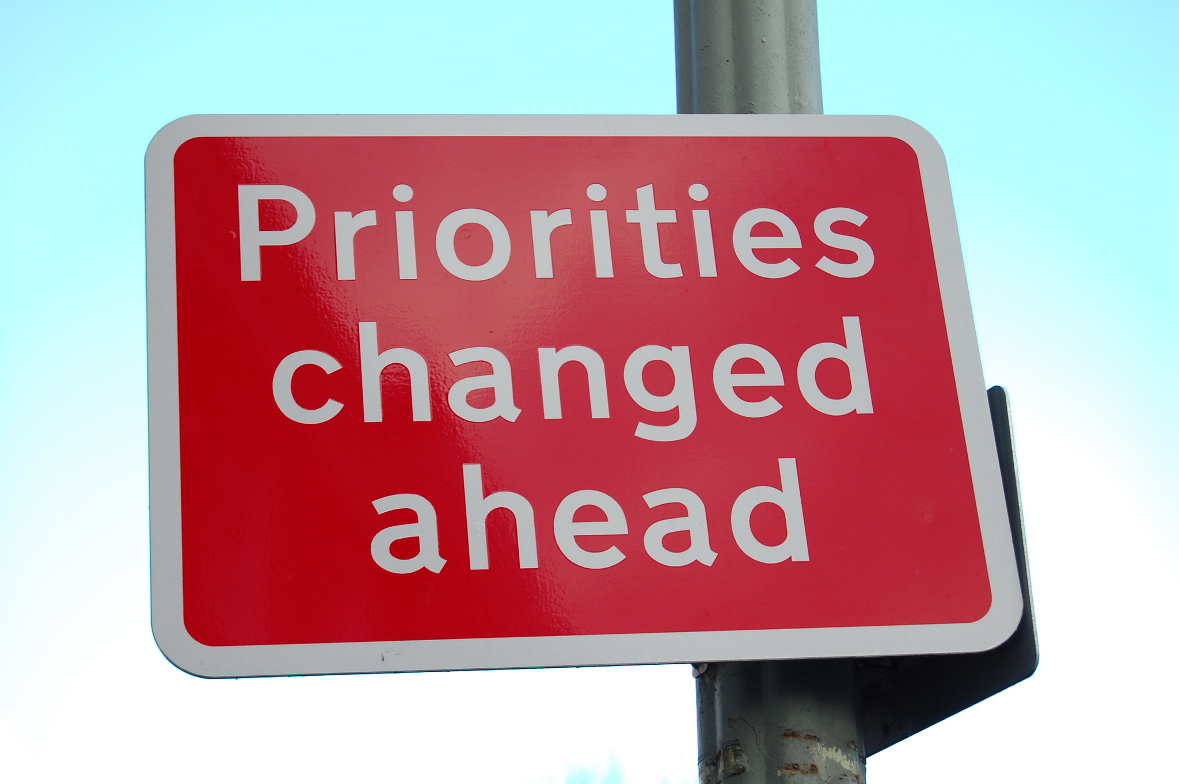
Advocacy
Advocacy is how you work to make policy makers see your issue as more important than they currently value it*.
Sharing stories of having services/supports, the change it creates
Stories of the lack of services/supports, negative effect
The effectiveness of the work, professional views
Also: science and data are helpful, but recognize that just like what we are seeing with other policy issues, science/data alone does not change people’s minds
*Advocacy isn’t the only strategy being employed: disability legal rights orgs have been suing over lack of access
Notes:
Note that at the end are some links to more info and our toolkit.

Slide 9
Samantha R Decision
Court has granted “motion for summary judgement” in favor of plaintiffs with I/DD vs state of NC: ruling in favor with no trial
Court: state has institutional bias and violates state law
People at risk of institutionalization, reinstitutionalizaiton
Lack adequate services and supports in community
Short version: Win!
We don’t yet know what the court will recommend as a remedy
Gathering information and recommendations
Remedy for plaintiffs vs other people in NC
Olmstead plan to be written by the state
Too early to tell NCGA what the fix is and what to fund
Opportunity to think beyond what we are currently doing, how we are currently funding
Notes:
Disability Rights North Carolina sued the state of North Carolina over the last two years on behalf of several clients whose main issues are lack of access to services in the community and re-institutionalization for their community living option.
[Cannot just remove state law protecting people with IDD/disabilities, same protections exist in Federal law.] Some remedy will have to be put in place at some point – likely one that increases access to some set of services and supports. What, we don’t yet know
Huge opportunity for looking at what a full array of services should look like, addressing direct support staffing issues, ensuring that people have choice in living arrangements, options for supports. We can address wait list issues, but also carefully look at adequacy and quality of community based supports. We can think beyond what we are currently doing.

Slide 10
Medicaid in North Carolina
Medicaid (federal funds with state match)
“Traditional” Medicaid
Doctor visits/Emergency Room/Medication/dental/
ICF-MR (Intermediate Care Facilities)
Other LTC: Personal Care, Adult Care Home, Nursing Home
Medicaid “Enhanced” Services
Mental Health and Addiction services and supports
“B3”- basic supportive MH/SA services, IDD (respite, DT)
SCHIP/Expanded Medicaid for Kids – “Health Choice”
Doctor visits/Emergency Room/Medication/dental/behavioral
Serves children above the poverty line who don’t qualify for Medicaid
EPSDT – Early Periodic Screening Diagnosis and Treatment
Catch-all funding for children – autism behavior treatment services (RBBHT) in Medicaid and Health Choice
Medicaid Home and Community Based Waivers (HCBS) under Managed Care
NC “Innovations” Waiver for people with IDD under managed care
Other CAP programs for children, adult disabled, elderly
Notes:
Medicaid basics:
Medicaid is not one single program. It is several programs with different eligibility and services. And it varies from state to state.
The Federal government’s Medicaid program was designed to assist low-income individuals in accessing health care services by matching state funds with Federal funds for approved health services. To qualify, people must meet income and asset criteria, as well as fit certain categorical requirements such as being: on the Temporary Assistance for Needy Families Program, a low income pregnant woman, disabled, or a child from a low income family. Most adults, and especially those without children, do not qualify for Medicaid. Some of this will changed in 2014 under the Affordable care act, however NC did not expand Medicaid to childless adult populations.
Medicaid classifies services and populations as “optional” and “mandatory.” The Federal government only requires that states cover limited populations and with limited services (for example, low income pregnant women for prenatal care and childbirth, children in foster care) – these are mandatory populations and services. In addition, they allow states to cover “optional” populations and “optional” services using the same matching fund formula. Every state chooses who to deliver services to, and what kinds of services; every state Medicaid plan and program is different. The Federal government through the Center for Medicare and Medicaid Services (CMS) approves those plans for how states will provide those services. Medicaid covers health services and supports that are medically necessary; it does not, for example, cover room and board in facilities, transport to school, and other related supports. That PLAN is called the state plan: ours covers 26 out of 28 optional services, BTW.
Once a plan is approved, those populations identified under the plan are usually “entitled” to the services outlined in the plan. One of the reasons states struggle with Medicaid budgets in difficult economic times is that more low income people are eligible and entitled to health care. To confuse things more, some programs under Medicaid – such as “waivers” - are not an entitlement. A limited number of people can receive a waiver and not everyone eligible for the waiver gets services. States in conjunction with the Federal government determine who and how many will be served; when the slots are full they do not automatically open more to serve all who qualify.
All services for treatment and support of people with MH, DD and SA are considered optional under Medicaid, as are all those populations. There are some exceptions to this, such as pregnant drug users or kids under Early Periodic Screening Diagnosis and Treatment (EPSDT), although enforcing services for kids under EPSDT has proven to be difficult. Other optional services are dental, orthopedics, vision, etc. The NC Legislature often talks about eliminating optional services because we are not required to provide them. They have yet to do so – though other states have. Advocates regularly make the argument that these Medicaid services are a great option because people stay in communities/at home and they cost less than institutional settings. That does not change the fact that the Feds don’t require states to offer these options.

Slide 11
“Expanding Medicaid” = Covering the Health Insurance Gap, Not Service Waivers
North Carolina has not extended Medicaid eligibility to low income adults who do not qualify for health care tax credits under the Affordable Care Act (Medicaid expansion)
Medicaid expansion covers a basic health care benefit package similar to ACA Marketplace or employer health plans (acute and emergency care, prevention, doctors, rehabilitative, mental health)
Medicaid expansion plans do not cover IDD habilitative services, long term care, or intensive autism behavior services
“Expanding Medicaid” does not mean expanding HCBS waivers or access to enhanced services
However, WE CAN DO BOTH!
Notes:
To clear up any confusion that I hear when people are talking about Medicaid Expansion in North Carolina. Expansion is important and we support efforts to make sure everyone has access to health care.

Slide 12
How Medicaid funds flow to NC today
NCGA
HHS – Federal Health and Human Services
CMS - Centers for Medicaid Services (Federal)
DHHS – Department of Health and Human Services (State of NC)
LME - Local Management Entities/ MCOs - Managed Care Organizations (County/Local)
Service Providers (of which UNC, Autism Society, etc. are one of many)
NC Medicaid – Division of Health Benefits/Division of Voc Rehab/Division of MH/DD/SAS (State)
Notes:
Explain the flow and the NCGA (i.e. waiver slots and PMPM).
Again, in order to talk about how Medicaid is planning to change, I need to point out how it currently works.
Does not account for current flow of funds into Physical health care system for regular Medicaid, Health Choice, dental care, etc. that runs parallel to this as a fee for service system.

Slide 13
Transforming to Managed Care: What’s That?
Per Member Per Month Pre-Paid Patient Rates
Generally moves to increased value by shifting the risk
How did we get here?
Area programs
Divestiture
Managed Care for Behavioral Health
And now…transformation
Notes:
Brief discussion about history, local/regional authorities, county appointed boards, manage services that are delivered by private providers. Paid PMPM to manage all the Medicaid MHDDSA services, including waiver funds.
Well known that many IDD organizations opposed the introduction of managed care into IDD services, including ASNC. Myself and my colleagues have spent a lot of time seeking to understand how managed care, carefully overseen, can be utilized to deliver better services, support whole person care, and use data to both use a systemic approach as well as treat individuals.

Slide 14
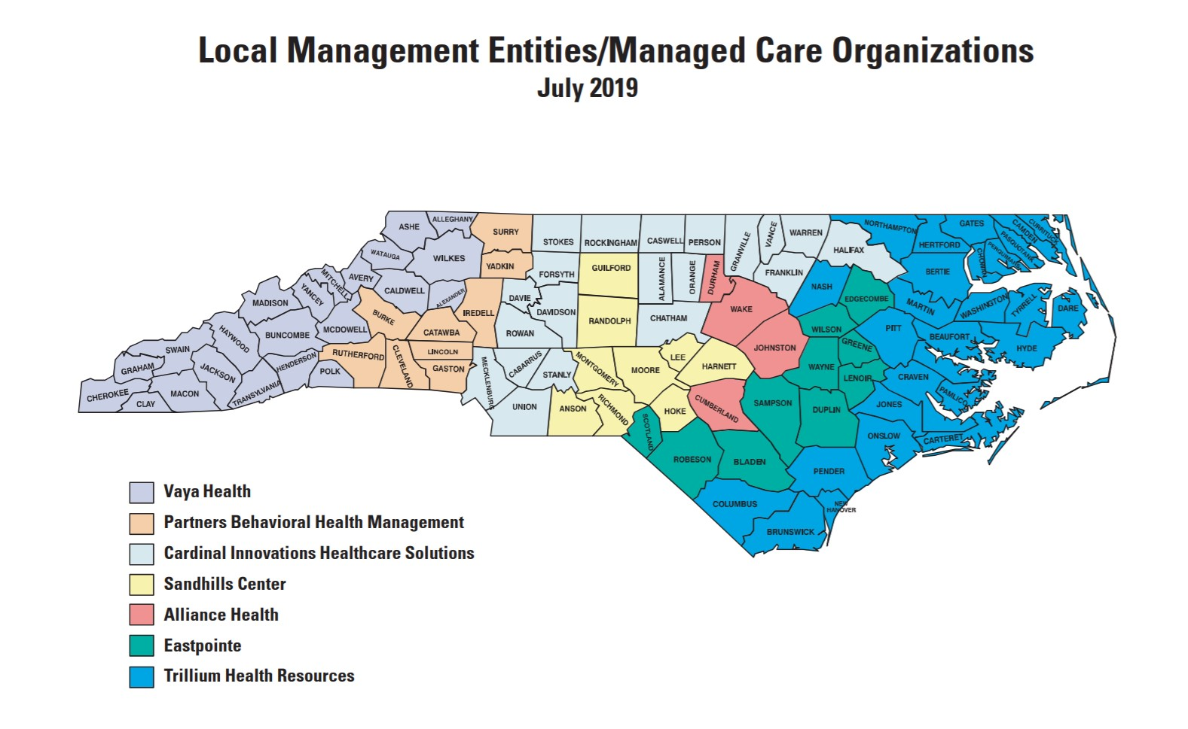
LME/MCOs aka Pre-Paid Inpatient Health Plans (PIHP) (Local Management Entities/Managed Care Organizations are Pre-paid Health Plans) Newest Map: https://www.ncdhhs.gov/providers/lme-mco-directory
Notes:
These are your LME MCO s and the regions they serve. PIHP = entity that has a contract with the state to deliver Medicaid behavior and developmental services under a managed care model, even though many of those services are not necessarily “inpatient.”
Explain LME MCOS and how we got here. (see previous slide as well)
Local authorities, county appointed boards, contract with state DHHS but answerable to board. Loose lines of authority. NCGA can remove funds, state can “take over” and remove boards. Lots of politics involved in eliminating contract – not clear that they could hand contract over to another LME, issue of property, staff, mergers, etc.
Responsible for ALL MHDDSAS for ALL of Medicaid.
Transitioning to new Tailored Plan, more on that later.
Managed care, local to state funding – will look different in a few years

Slide 15
Medicaid Transformation = Change is coming
Requires Medicaid to move to an at risk, capitated, managed care 1115 waiver
1115 waiver is the federal authority used to accomplish the intent of the state law for Medicaid Transformation
MHDDSAS currently operates under the 1915b/c managed care waiver
Goal of reform is to deliver whole-person care through coordinated physical health, behavioral health, intellectual/developmental disabilities and pharmacy products and care models
Address the full set of factors that impact health, uniting communities and health care systems
https://www.ncdhhs.gov/assistance/medicaid-transformation
*slides 16-19,21,23 DHHS i2i presentations (T.Larson, K.Kinsley, D.Richards)
Notes:
Legislature decided that Medicaid needed to be managed differently, merge behavioral and physical health, use managed care and private managed care companies.
At risk, capitated, managed care BILLIONs of dollars –hospitals, MDs, and the Behavioral Health system

Slide 16
The Medicaid Standard Plan and the Tailored Plan
The 1115 waiver options offers Standard Plan (SP) and Tailored Plan (TP)
SPs will be the default plan for most Medicaid recipients. SPs will be operated by Commercial Plans (CPs) and Provider Lead Entities (PLEs).
TPs will be the specialty plan for certain behavioral health/IDD individuals.
Individuals served currently by the 1915b/c waiver (LME-MCO system) will be either in the SP or the TP depending on Diagnosis and services.
Notes:
Determined we would divide eligible into two plans: SP and TP
CMS will hold DHHS accountable, DHHS will hold SP/TP accountable, SP/TP will hold providers accountable

Slide 17
Behavioral Health Integration and Tailored Plan
NC will integrate physical, behavioral and pharmacy benefits into both the Standard Plan and the Tailored Plan (TP)
This means physical health care as well as MH/DD/SAS, together in both the SP and the TP
TP will provide
Integrated benefits to SMI, SED, Severe SUD, IDD or TBI
This means physical health care as well as MH/DD/SAS
More extensive BH/IDD benefit not in the SP
Care Management through a specific BH/IDD health home model designed to meet complex needs

Slide 18
Notes:
Other huge piece of 1115 – exploration to address health barriers, pilots/grants to come out soon around Employment, Housing, Food Insecurity, transportation, personal safety. Grants to come out for these soon also.
NC DHHS as a whole will also focus health care plans, partners, agencies, providers on addressing social determinants of health, DSS having to step up, everyone having to prove their value.

Slide 19
Standard Plan
All Medicaid benefits plus (minus Dental, LEA, PACE)
Inpatient behavioral health services
Outpatient behavioral health services including services provided by direct enrolled providers
Mobile Crisis Management
Diagnostic Assessment
Partial Hospitalization
Facility Based Crisis (child/adult) and Professional Services
Ambulatory Detoxification
Non-hospital Medical Detox
Medically Supervised or ADATC Detox Crisis Stabilization
Outpatient Opioid
Research Based Intensive BH Treatment for Autism Spectrum
Early and Periodic Screening Diagnostic Treatment (EPSDT)
Notes:
Just a reminder, the standard plan will be delivered by private managed care and regional provider led private health insurers.
To show they can manage these services, plus physical health care, plus healthy outcomes – bc shared risk under PMPM
Choice of plan for consumers

Slide 20
Standard Plans
AmeriHealth Caritas
BCBSNC – Healthy Blue
Carolina Complete Health (PLE) – Regions 3, 4, 5
United Health Care
WellCare Health Plans
Notes:
Have you seen the billboards? Heard the commercials? What are they bidding for again?
Creative ways to deliver all services and address SD, whole person care

Slide 21
Notes:
Notice these are different from the LME MCO regions? What will happen?

Slide 22
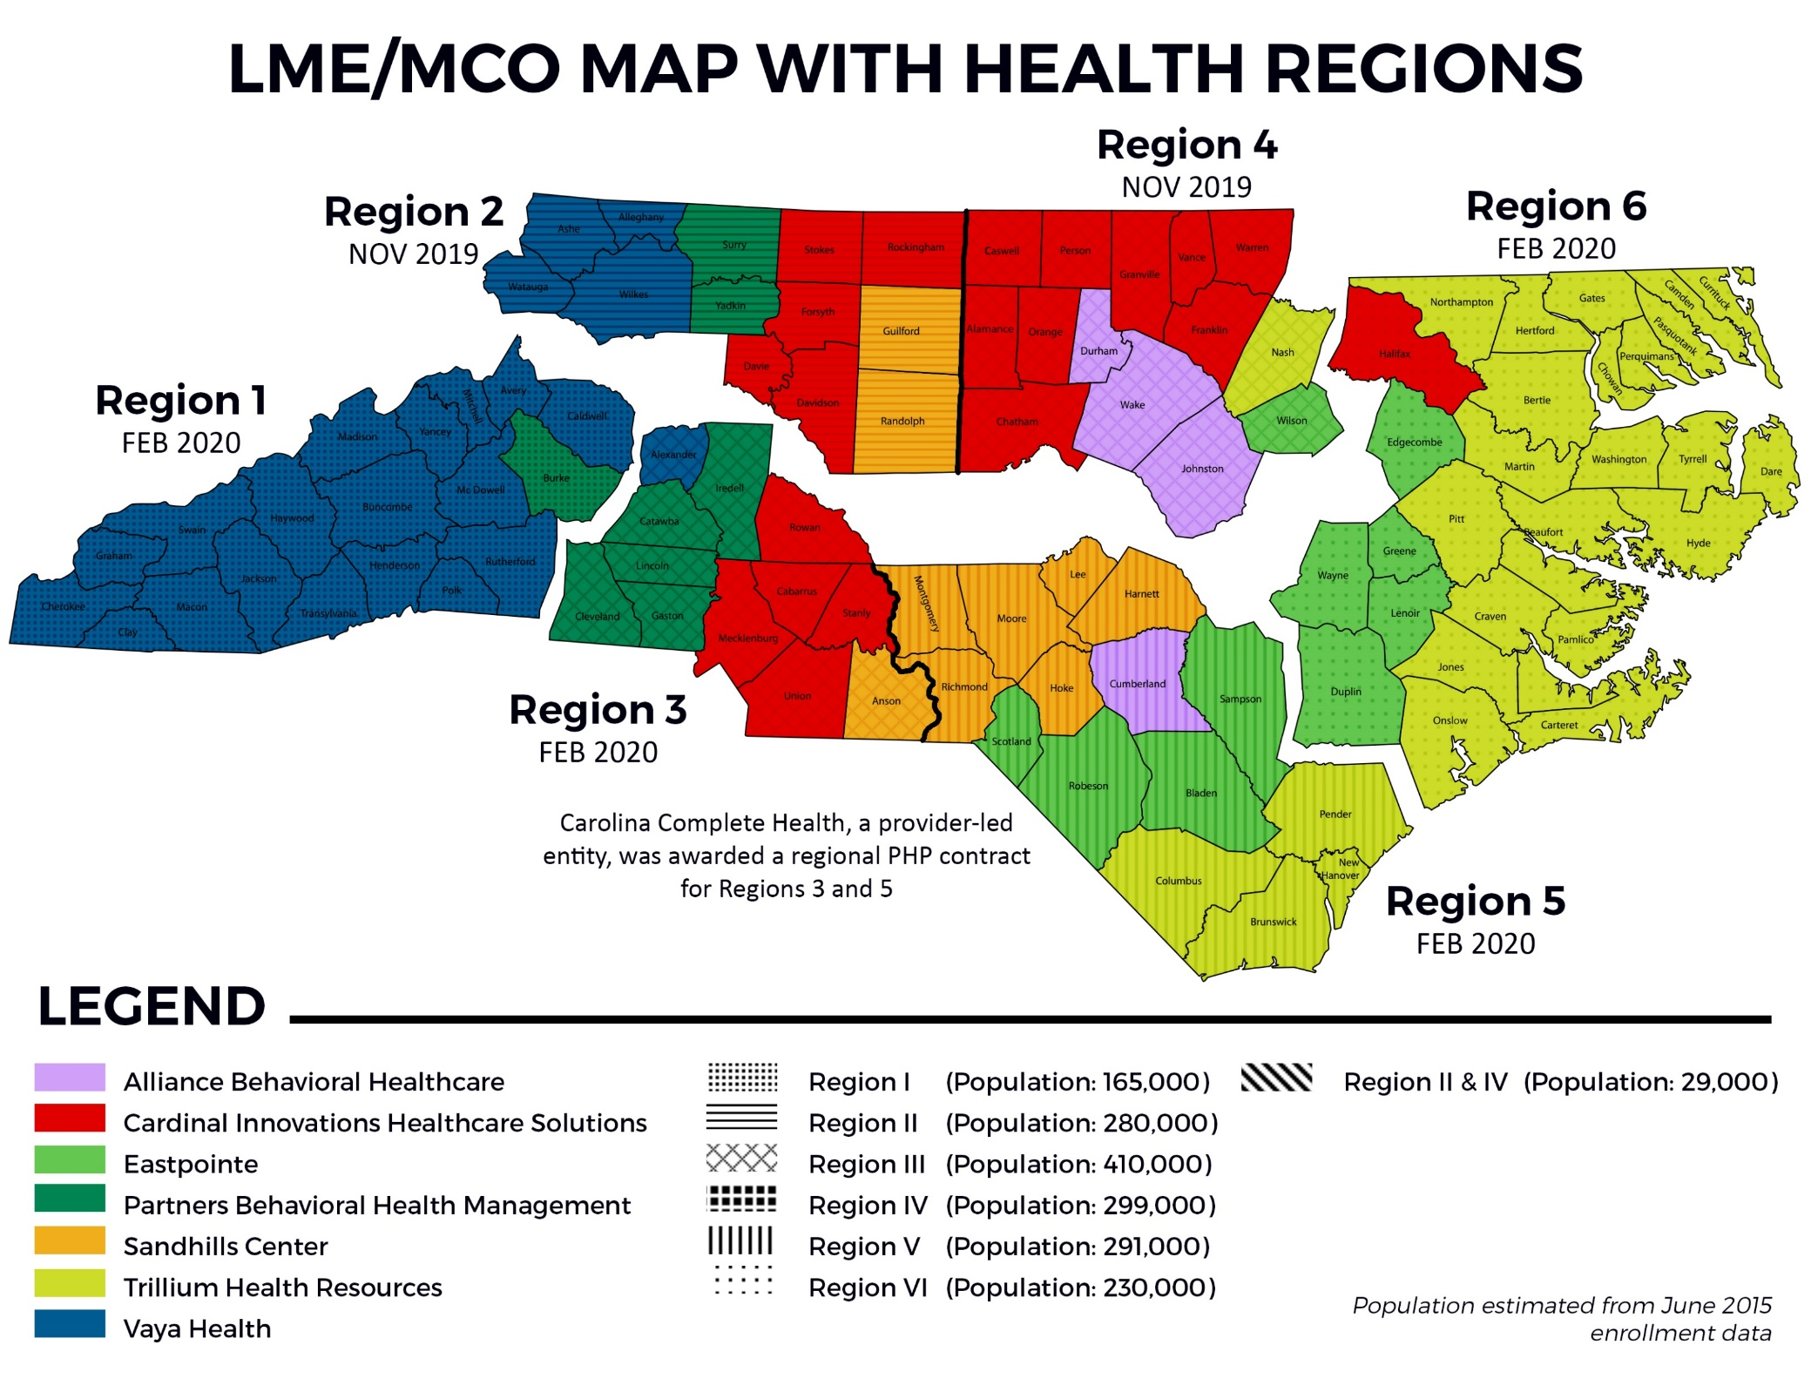
Notes:
Note that two counties on here have changed LMEs since the map was created by DHHS.

Slide 23
Tailored Plan
All Medicaid benefits (minus dental, LEA, PACE) PLUS
Residential treatment facility services
Child and adolescent day treatment services
Intensive in-home services
Multi-systemic therapy services
Psychiatric residential treatment facilities (PRTFs)
Assertive community treatment (ACT)
Community support team (CST)
Substance abuse non-medical community residential treatment
Substance abuse medically monitored residential treatment
Intermediate care facilities for individuals with intellectual disabilities (ICF/IDD)
WAIVER and STATE SERVICES
TBI waiver services
Innovations waiver services
1915(b)(3) services
All state funded BH and IDD Services
State funded TBI services
Long-term employment/Supported employment services (non-VR)
Notes:
Reminder, Tailored Plans will be delivered by LME MCOs that are able to meet the same criteria as the private insurers. Then after the first four years those contracts would be put out to bid and any of the current or other health plans can submit proposals to be the contractors (if they meet the criteria and are selected).
No choice of plan for the participant/consumer; your managed care company is still based on the region you live in.
Medicaid Tailored plan participants will have a choice of providers within the network and a choice of care management providers.
Tailored plans are the ONLY place to get state funded and locally funded MH/DD/SAS services, IPRS dollars, grant, B3 dollars. If you are getting ANY kind of state funded service, that will not be available in the Standard Plan.

Slide 24
How Medicaid funds will flow
HHS – Federal Health and Human Services
CMS - Centers for Medicaid Services (Federal)
DHHS – Department of Health and Human Services (State of NC)
Maximus (Enrollment Broker working alongside DSS)
Service Providers
NC Medicaid – Division of Health Benefits /Division of Voc Rehab/Division of MH/DD/SAS (State)
NCGA
Standard Plan choices
(i.e. Amerihealth, Healthy Blue, Well care, etc.)
Tailored Plan assignment
(LME/MCO’s until 2025)
Notes:
Explain the flow and the NCGA (i.e. waiver slots and PMPM), contracts address PMPM and admin costs, keeping in mind that this still does not address waiver programs like Innovations that require legislative authorization and funding for more slots.

Slide 25
New Elements of Transformation
Integration of Physical and Behavioral Health in SP and in TP
TP entities (LME MCOs) are new to Physical Health management
Partnerships will likely develop with other organizations
Care Management for IDD/Case Management for MH/SA
Healthy Opportunities demonstration projects
Ombuds program – additional participant oversight
Advanced Medical Homes – primary care w/ care mgt, population health mgt
Enrollment – rollout, yearly changes, “life event” changes
Maximus working with DSS
Integration of health data and care delivery/management
Move to Value Based Payments – pay for quality
Opportunities for focus on financial accountability, outcomes, coordination, access
Potential for disruptions of providers, administrative and care coordination staff, competition amongst providers and entities
Notes:
Review slide content, note following slides contain information that they can review on own about new elements of transformed system.
Tailored plans (and Standard Plans) are delivering both physical, behavioral and developmental health and disability services, so they must contract with Private Health Plans and Behavioral providers to deliver in an integrated way all of those services.
We still need legislative changes to ensure that some of the elements of the current LME MCO system carry over into the new transformed managed care system: CFACS, cross county appointed oversight boards, other issues still need to be resolved.

Slide 26
What is Integrated Care?
Enrollees and providers will have seamless experience under one plan for Behavioral Health (BH), Intellectual/Development Disability (I/DD), TBI, Innovations Waiver, and Physical Health services.
Principles of Integrated Care
Places the person at the center of care and treats them as a whole person
Care provided recognizes interactions between physical health, behavioral health, TBI, and I/DD needs and is based on evidence and best practices
The State maintains a single point of accountability across all service types for the enrollee Comprehensive care management serves as the “glue” to ensure integration
Integration promotes improved health outcomes, and the State will reward plans based on performance to further incentivize integration
26

Slide 27
Care Management
Tailored Plan enrollees will have a new model of care management, addressing physical health, behavioral health, I/DD, pharmacy, unmet resource, and other needs.
Key Components of Integrated Care Management:
A single care manager for every enrollee. Every BH I/DD TP enrollee will be eligible for care management and have access to a care manager trained to coordinate a comprehensive set of services addressing all of the enrollee’s needs; enrollees will not have separate care managers to address physical health, behavioral health, TBI, and I/DD-related needs.
Holistic, person-centered planning. Enrollees will receive a care management assessment that evaluates all of their needs—from physical health, behavioral health, TBI, and I/DD services to employment and housing—and drive the development of a care plan that identifies the goals and strategies to achieve them.
Emphasis on local care management. Care managers will primarily be based in community-based care management agencies and Advanced Medical Homes with behavioral health and/or I/DD certification, and will be required to have face-to-face interactions with enrollees.

Slide 28
Care Management, Cont.
Key Components of Integrated Care Management, Cont.:
Multidisciplinary care teams. Each enrollee’s care team, coordinated by his/her care manager, will consist of a multidisciplinary group of clinicians and service providers (e.g. primary care providers, behavioral health and I/DD or TBI providers, pharmacists, nutritionists, community health workers, peer supports, etc.) with the ability to address all of the enrollee’s needs.
Clinical consultation. Care managers will have access to clinical consultants across primary care and psychiatry.
Addressing unmet resource needs. Care managers will connect enrollees to programs and services that address unmet health-related resource needs (e.g. housing, food, transportation, interpersonal safety, employment, etc.), including through healthy opportunity pilots in regions where available.
Data strategy. The BH I/DD TP design will also include strategies for the state and key TP stakeholders to bridge data silos, and facilitate the timely and secure exchange of information to support and inform integrated care management.

Slide 29
Advanced Medical Homes (AMHs)
The State’s Advanced Medical Home model aims to integrate care delivery and care management across service types at the local level.
Advanced Medical Homes (AMHs) are DHHS-certified primary care practices that will offer population health management at the local level, including enhanced care management
Design work on how AMHs will work within the Tailored Plan context is just beginning, but will aim to align with the principles of integration and with the AMH program launching alongside Standard Plans
More information on AMHs is available in a series of webinars and materials available online at:
https://medicaid.ncdhhs.gov/amh-training

Slide 30
When is this all happening?
2019 SP Plans were selected, recipients were assigned, and enrollment letters started to go out… However, Transformation has been delayed until budget impasse has been resolved or the legislature passes $.
RFA for Tailored plan is out and moving forward.
The next phase would include (if funds are available):
Enrollment would re-start and enrollment letters re-sent
Medicaid Managed Care SP will start in Phase 1 regions
Medicaid Managed Care will start in the Phase 2 regions and will be available across the state.
One year after Standard Plan implementation, Tailored plans will be implemented by LME/MCOs qualified to run them (per current legislation)
Four years after that, (per current legislation) TP’s out to bid
Notes:
We are in a huge holding pattern on Transformation, planning is still going on in anticipation of legislative changes and a budget passing, but there is no budget.
We still need legislative changes to ensure that some of the elements of the current LME MCO system carry over into the new transformed managed care system: CFACS, cross county appointed oversight boards, other issues still need to be resolved.
Talk about why things are on hold: budget impasse, unclear when it will start up again.
What about those MCOs? https://advancingncwholehealth.com/
MCO’s gearing up to run TP’s – care management, care coordination platforms, SDOH, value based

Slide 31
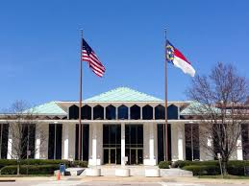
NC State Budget
Two year NC state budget was not passed into law
Governor vetoed budget that NCGA passed
House overrode veto, Senate needs one D to vote with Rs to override
NC is operating under a continuing budget; law allows for current budget to stay in place unless over budget
Budget that was passed has some good things, but also problems
People with IDD needs going unaddressed: waitlists, not enough support staff, uninsured/underinsured, no state funded services, special education funding formulas not fixed, lack of education services
Lack of budget is preventing Medicaid Transformation
Notes:
Short session starts at end of April. Very difficult to predict the outcome right now, all signs point to no large budget bill being passed. Possible mini-budgets for adjustments to education funding to meet attendance increases, bills to authorize Federal funds to the state.

Slide 32
Federal Budget
Congress passed spending bill end of last year: small increases, but mostly flat funding
Presidential budget released recently recommends steep cuts to safety net and health programs like Medicaid, Medicare, and Social Security, SNAP, as well as autism specific funding for the CARES Act, supportive employment grants, CDC research.
Opportunity to talk with Congress about importance of Social Security, Medicaid, Medicare, Food Stamps, etc. in the lives of people with disabilities

Slide 33
Other Federal Bills and Issues
HCBS Infrastructure Improvement Act
Bills to extend/modernize family leave/medical leave
Family Medical Leave Modernization Act (HR 5456)
FAMILY Act (HR 1185).
Attempts to block grant Medicaid continue
CMS now allowing flexibility in new adult coverage waivers
Some members of Congress opposed, House resolution passed

Slide 34
Federal Rulings, Announcements
Comments can be made on proposed rule limiting travel by air with service animals
https://www.regulations.gov/comment?D=DOT-OST-2018-0068-12959
ASA Ignite Newsletter – Updates on Federal Public Policy
https://www.autism-society.org/public-policy/

Slide 35
NC Voting changes: No ID
Lawsuit has stopped implementation of voter ID in NC
No ID was needed to vote in Primary in March
Unlikely to need ID to vote in General Election in November
www.ncsbe.gov
Notes:
Continue to keep an eye on information on voting on the state board of elections website and by mail.

Slide 36
NC Voter Accessibility
DRNC initiative Access the Vote NC https://www.accessthevotenc.org/
Includes 2020 Voter Guide
Voters in congregate settings can request help voting from a local Multi-Partisan Assistance Team (MAT) through their local board of elections
Owners/staff of care homes, nursing homes, hospitals cannot assist directly in voting but can help facilitate the work of the MAT with their residents
You selections are your own, but voters can get help at the polls with filling out a ballot, just not from your employer or union
Voters with any condition can vote curbside
You do not have to show proof of disability

Slide 37
NC Voting changes: Absentee Voting Updates
Plan ahead to vote absentee
Absentee ballots must be requested by the voter or the voter’s “near relative”, including legal guardian
Near relative includes spouse, brother, sister, parent, grandparent, child, grandchild, mother-in-law, father-in-law, daughter-in-law, son-in-law, stepparent, or stepchild AND legal guardian
If absentee ballot is requested by someone other than the voter, that person must also provide their name and info on ballot before it is delivered
Ballots must be delivered by the voter or the voter’s near relative/guardian or US mail.
https://www.ncsbe.gov/Voting-Options/Absentee-Voting
Notes:
No one else besides voter near relative or guardian can request ballot.

Slide 38
US Census: Be Counted!
Counts entire population, citizen and non citizen
Fist time available online, will get postcard with info
Can also fill out via phone, paper mail in, in person with census worker
Is secure and info cannot be used against you
Determines distribution of your Federal tax dollars
Schools, roads, infrastructure, economic development, Voc Rehab, etc.
Could add another seat in Congress to NC – increased representation!

Slide 39
Contacting Elected Officials
Find out what agency/part of government is in charge of your issue
Some issues are Federal, some state, some local
Some are a combination
Keep your message brief and to the point
Your elevator speech: a three point message (next slide)
One page letter: introduce, state your message including a solution, thank them
Contact them
Fact to face is great, but not everyone can (travel, time, appointments)
Writing/Emailing: good for telling your story, asking for action
Calling: Good for issue with immediate action needed, tallying your opinion
Social Media: pros and cons; avoid calling out; good for acknowledgements; ok for drawing attention to issue, opinion counting
Notes:
ASNC can help sort out who you need to advocate with on your issue. Email or call me!

Slide 40
Craft Your Message
Three main steps:
State problem
Tell why its important to you
Suggest your solution
Should be able to make these three single statements.
You can embellish if you know you have more time in person and/or space in writing.
This Photo by Unknown Author is licensed under CC BY-NC

Slide 41
Keep It Respectful
You can be passionate, but keep your words courteous
Make your point, but avoid arguing
Don’t make threats (“I’m not going to vote for you”, etc.)
Avoid blaming, finger pointing
You have a short amount of a policymaker’s time and attention: use it wisely

Slide 42
Advocacy Toolkit
Autism Society of NC website
Click Gain Knowledge
At Left: Learn Online, Click “Toolkits”

Slide 43
ASNC Public Policy Priorities
Broad Areas of Focus, Specific Targets
Access to Services
Access to Education
Rights and Freedoms
System Management and Managed Care
Current targets https://www.autismsociety-nc.org/public-policy-priorities/
Keep up to date on ASNC Public Policy News
https://www.autismsociety-nc.org/make-voice-heard/

Slide 44
Contact Information
Jennifer Mahan
Director of Public Policy, ASNC
919-865-5068
jmahan@autismsociety-nc.org

Slide 45
5121 Kingdom Way, Suite 100 Raleigh, NC 27607 1-800-442-2762 www.autismsociety-nc.org

