Slide 2
Our Mission:
To use technology training and life skills education to cultivate the potential of people with autism to obtain fulfilling, living wage jobs and live meaningful, independent lives.

Slide 3
(picture of the kids at age 10)

Slide 4
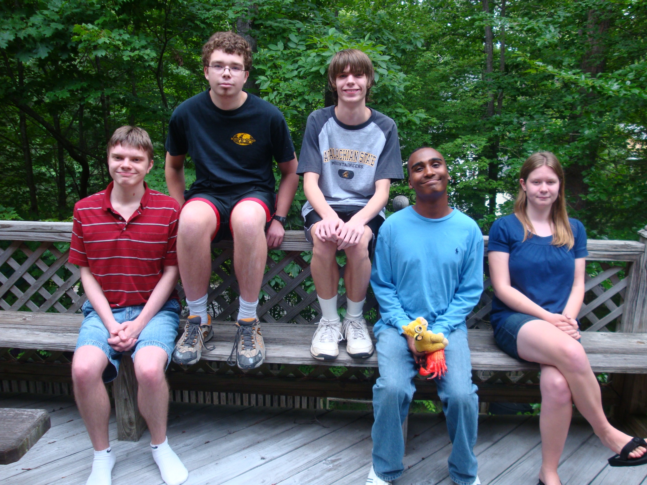

Slide 5
The problem
According to the National Longitudinal Transition Study 2 (from the National Center for Special Education Research) from September 2011:
( This looks at Post High School outcomes of young adults with disabilities
up to 8 years after high school.)
43% of people with high functioning autism have ever enrolled in a vocational, technical college or four year college program.
38% of those who have ever enrolled in a post secondary are “completers” or 16% of the total population of people with HFA.
35% of individuals with ASD have no organized daytime activities
20% of individuals with ASD lived independently or semi-independently

Slide 6
The problem
63% of persons with ASD had had employment at some time during the 8 years after high school
Those employed worked an average of 24 hours per week
Less than half had paid vacation, health insurance or retirement benefits
The average amount of time spent looking for a job was 12.3 months
77% had assistance from a family member, friend, teacher or agency to find their job
Only 5.4% received any accommodations on the job

Slide 7
Why technology jobs?
Characteristics of the thinking and learning style of autism may lend themselves excelling at jobs such as coding and software testing:
An affinity for and understanding of technology
Visual thinking and learning skills
The ability to concentrate for extended periods on repetitive activities
The ability to identify subtle details and changes
High levels of persistent and comfort with repetition and routine tasks
Excellent memory skills
Logical thinking skills
High levels of integrity and strong loyalty

Slide 8
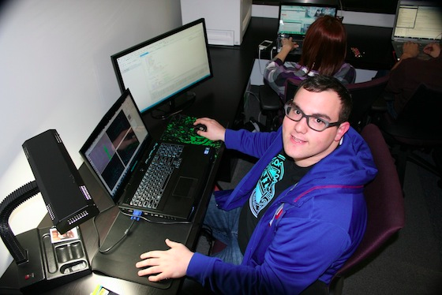
Problem:
Error Rates
Tedium
Fatigue
Exhaustion
Quality Problems
Lack of Attention to Detail
Solution:
Error-Free
Enthusiasm
Energy
Persistence
Quality Assurance
Meticulous

Slide 9
Persever8 history
Class at UNC-CH (EMBA Program – Soft Launch)
Continued advisement from SCORE mentor
Launch Chapel Hill Program
CUBE Mentorship
Board of Directors
Technology Board
501(c)3 Nonprofit status
Funding
The Frontier
Affiliate of the CIDD

Slide 10
Pilot Program Phase 1
Due diligence – research similar companies
Life skills / workplace readiness
Literature search – best practices, empirical studies
Donation from CODE HS
Participants / Outcomes

Slide 11
Pilot Program phase 2
Objectives of the pilot program:
Can individuals on the autism spectrum “dig deep” and become proficient in the use of coding languages?
Is there a specific profile candidate with autism that is more likely to be successful in software testing or programming?
Thinking and learning style
Temperament
Insight
Ability to work in a group
Ability to allow others to critique their work – Git-hub
Team building activities
Stamina

Slide 12
Pilot program phase 2
Began February 2016
Donation from Code Avengers
Two Apples Service Learning class interns help with life skills and team building exercises
11 participants from Wake, Orange and Durham Counties
Meet Saturday mornings at the Frontier in RTP

Slide 13
Pilot program phase 2
Each week:
Team building exercises
1 ¼ hour of coding
45 minutes of life skills/workforce readiness lessons
Parent volunteer helping with trouble shooting
Technology board oversight
Technical support from Code Avengers

Slide 14
Launching in september 2016
New space in the Frontier
10-12 participants
Tuition funded
5 days a week
Coding, Life Skills and Workforce Readiness Training
9 month program
Internship at Technology Company in Summer 2017
Support for sponsoring companies prior to and during internships
Support for trainees from Persever8 during internship

Slide 15
Thank you!

