Slide 1
Creating Meaningful Jobs for Adults with Autism
Social Entrepreneurism in the Community
Paige Morrow
Managing Director

Slide 2
The Vision
Portfolio of Businesses
Self-Sustaining
Full Minimum Wage
Independent of Government Funding

Slide 3
Who We Are: Extraordinary Ventures, Inc.
Unique Features:
Portfolio of businesses
Jobs are designed around the individuals
60 employees
Employ the full spectrum
501(C)3 with a for-profit mindset
Managed by team of young entrepreneurs
Replicable model

Slide 4
EV Structure: A Balanced Portfolio
2015 Paid Employment Hours by Venture

Slide 5
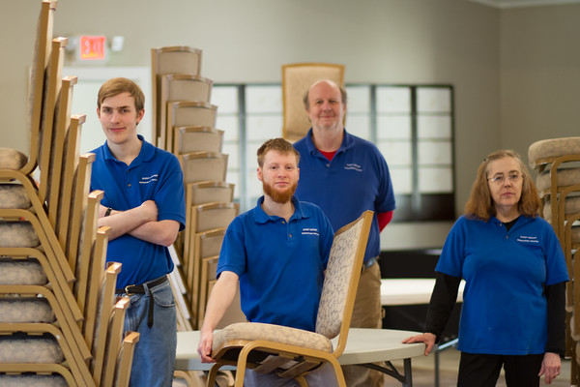
Event Center
Notes:
Flagship business

Slide 6
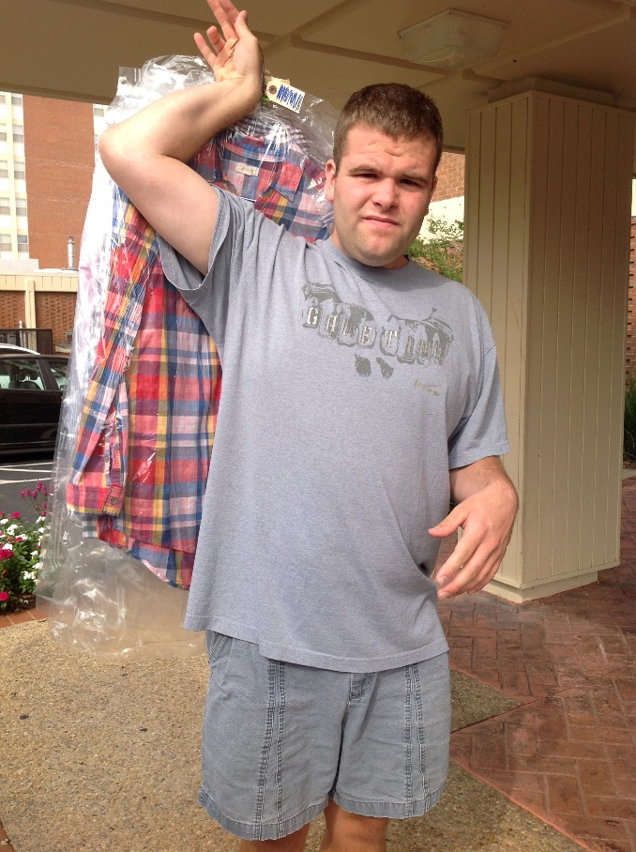
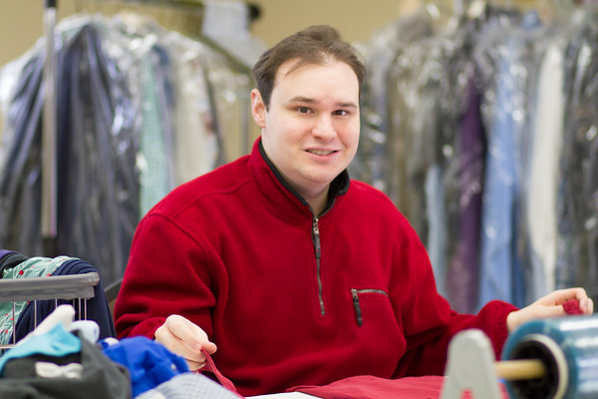
EV Laundry

Slide 7
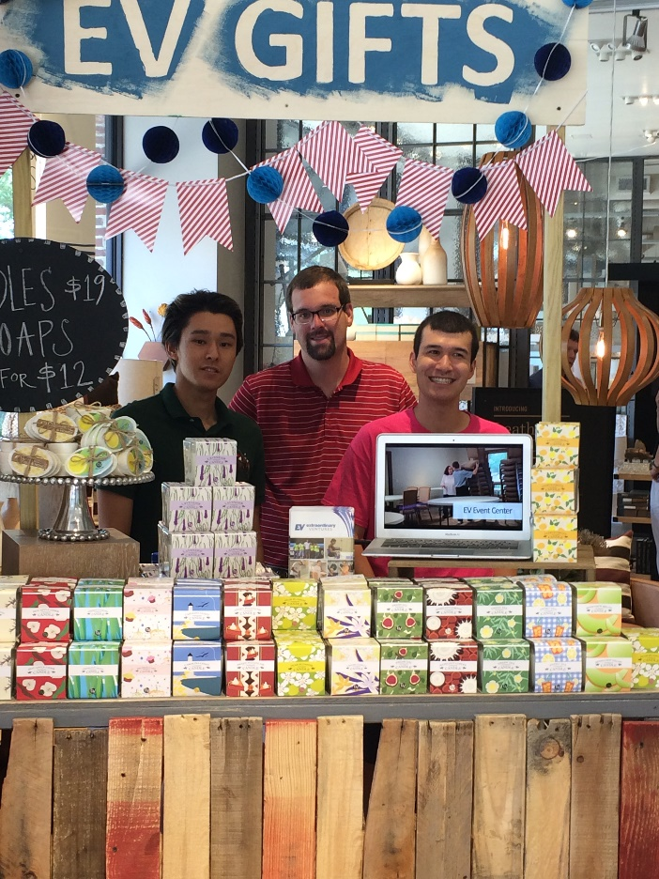
EV Gifts

Slide 8
EV Bus Crew

Slide 9
Office Solutions

Slide 10
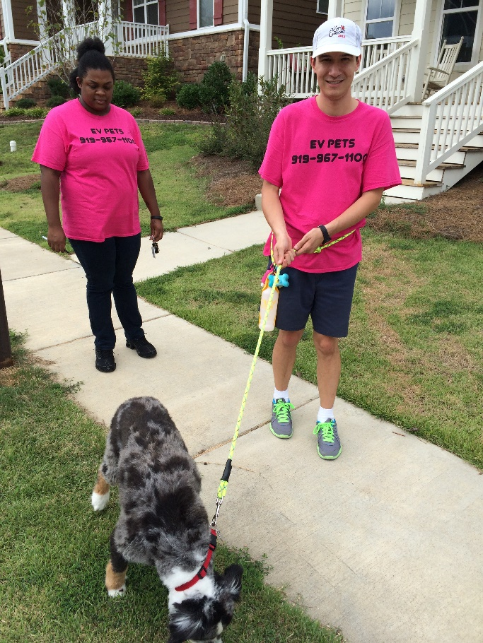
EV Pets

Slide 11
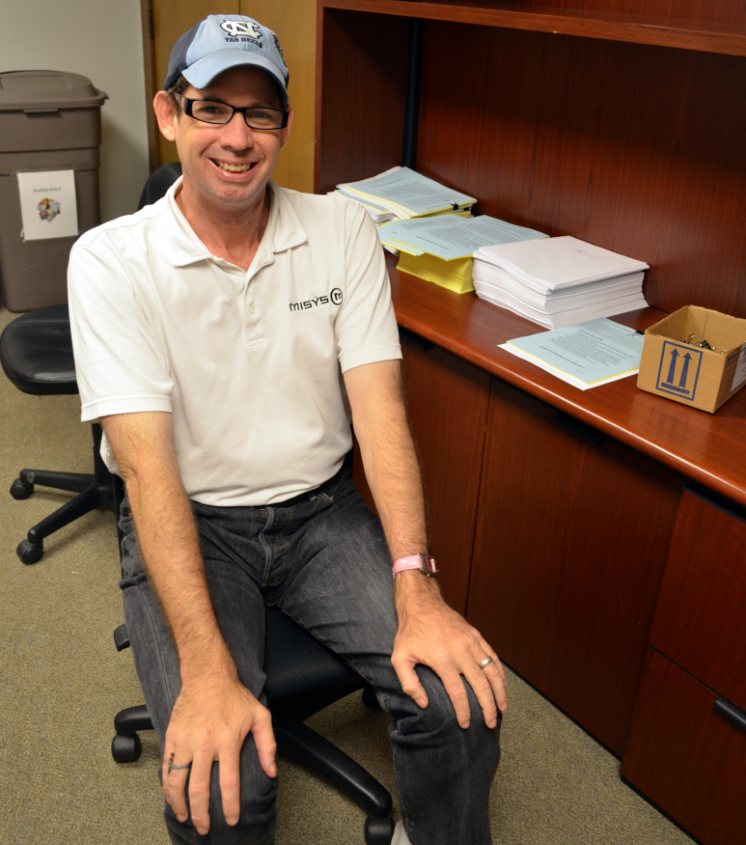
EV Fits the Job Around the Person

Slide 12
A Sample of EV Jobs
Laundry
Sort & inventory
Operate machines
Fold & pack
Pick up & delivery

Slide 13
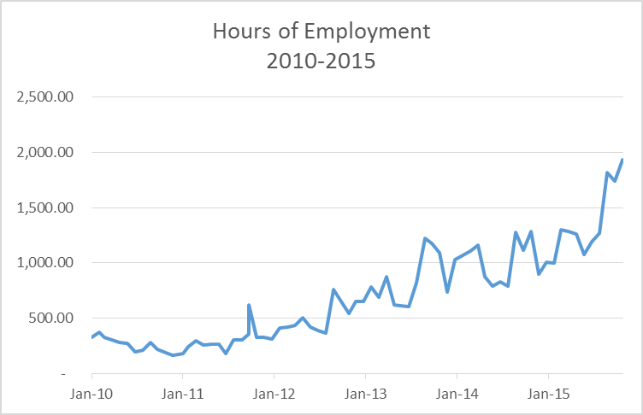
Hours of Employment

Slide 14
50% Growth

Slide 15
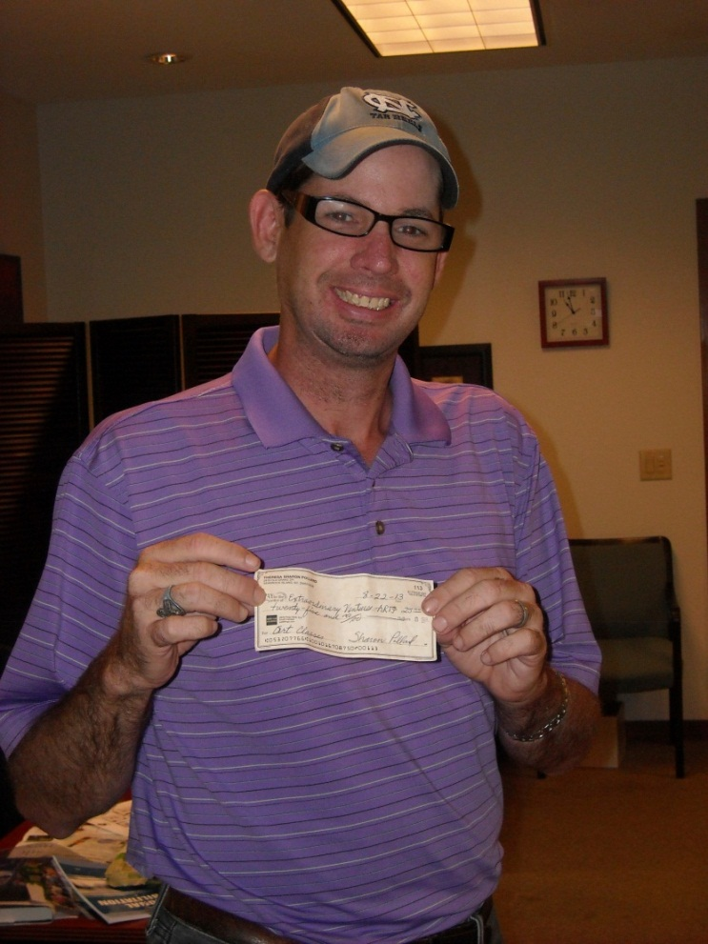
The Real Payoff

Slide 16
The Real Payoff

Slide 17
Our Goals
To inspire and motivate.
To be a model.
To provide meaningful jobs for our employees.

Slide 18
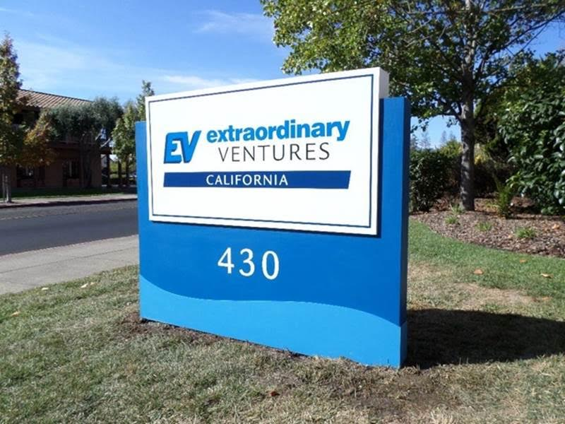
Replication Partners

Slide 19
Lessons Learned
Get started—this is the hardest part!
Focus on local markets
Treat it as a real business
Embrace trial and error

Slide 20
www.extraordinaryventures.org

